Slide 1


BUSINESS MANAGEMENT SYSTEM
SOFTWARE ENGINEERING

Slide 2

CONTENT
01
INTRODUCTION
02
USE CASE DIAGRAM
03
SEQUENCIAL DIAGRAMS
04
ACTIVITY DIAGRAMS
05
CLASS DIAGRAMS
06
LINKS

Slide 3

INTRODUCTION
Business Management System (BMS) is tailored for Small and Medium-Scale Enterprises (SMEs) to enhance growth and competitiveness.
BMS integrates mobile and desktop applications via the cloud for efficiency and agility.
Core functions of BMS include inventory management, HR, expense tracking, dues management, and business analytics.
It acts as a digital backbone, providing tools for entrepreneurs to navigate complexities and capitalize on opportunities.
Features include precise inventory tracking, streamlined HR processes, meticulous expense management, and robust analytics.

Slide 4
Customizable reports and visualizations offer insights for informed decision-making and strategic planning.
BMS optimizes day-to-day operations and sets the stage for long-term success.
It empowers SMEs to maximize revenue, streamline processes, and adapt to market dynamics.
BMS is a comprehensive solution beyond traditional management systems.
It is a catalyst for growth in the competitive landscape by empowering SMEs.

Slide 5
Proposed System Goals and Objectives:
Cross-Platform Application
Data Security and Synchronization
Inventory Management
Expense Management

Slide 6
Business Management
Due Management
Human Resources Management
Invoice Generation and Automated Customer Delivery
Reporting

Slide 7

UML DIAGRAMS
USE CASE DIAGRAM
SEQUENCIAL DIAGRAMS
CLASS DIAGRAM
ACTIVITY DIAGRAM

Slide 8
USE CASE
- It delineates roles and responsibilities across Different functional areas for clarity.
- Task dependencies are highlighted, showing how various tasks are interconnected and reliant on each other.
- Automation and reporting functionalities are emphasized, demonstrating our commitment to efficiency and data-driven decision-making.
- This visual representation serves as a valuable tool for strategic planning and day-to-day operations management, fostering clarity and alignment across the organization.

Slide 9
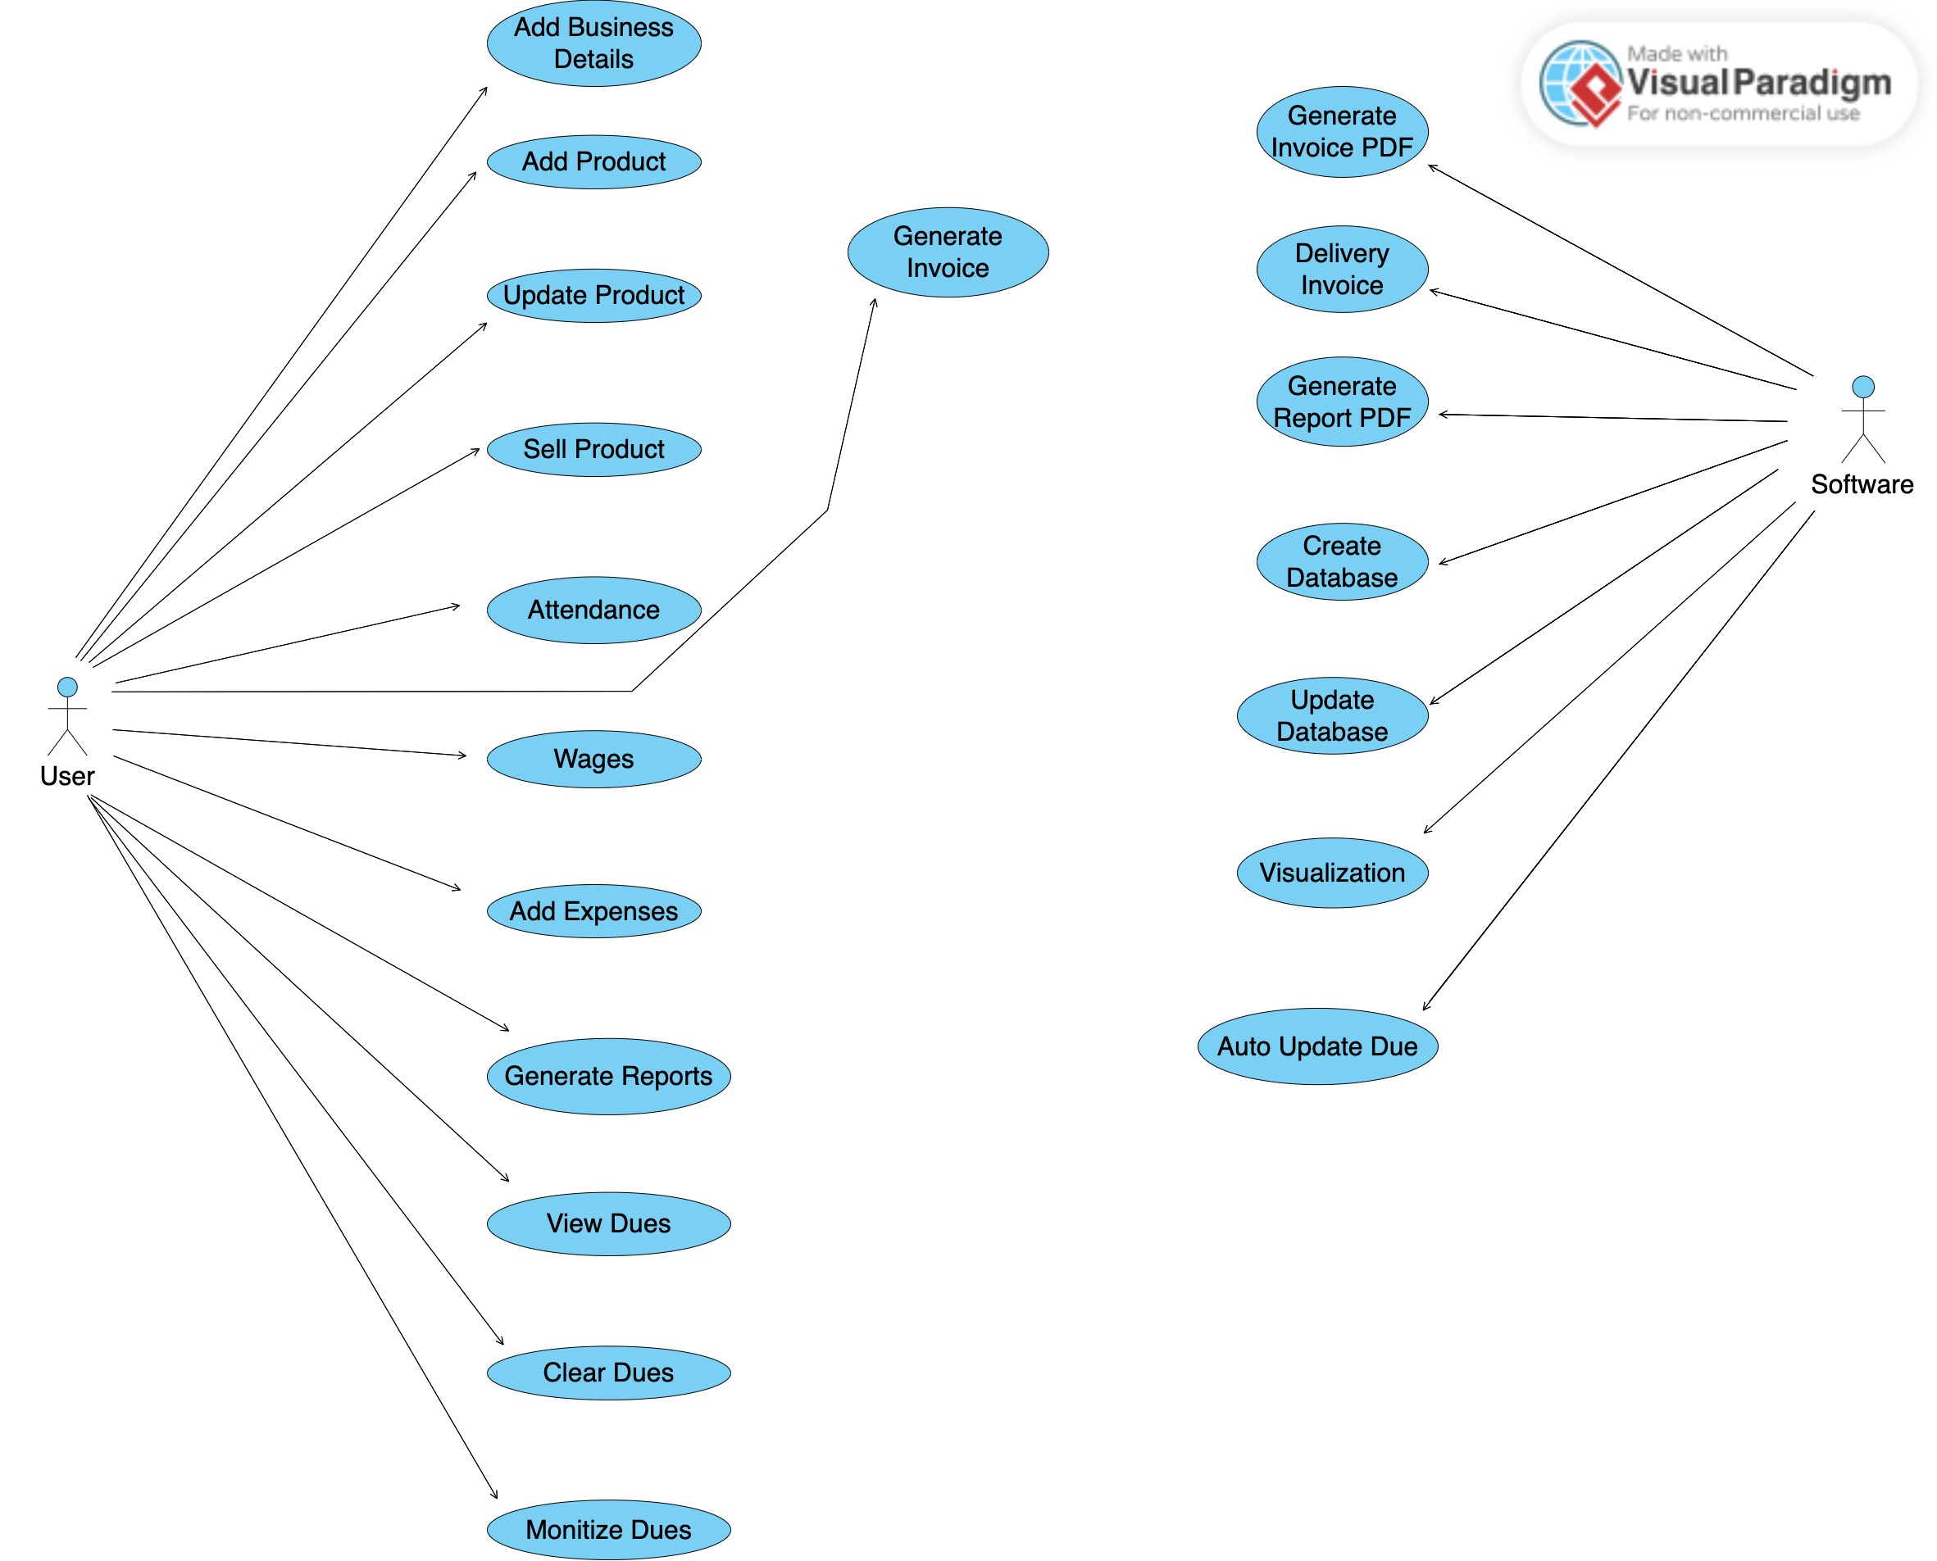
USE CASE DIAGRAM

Slide 10
SEQUENCE DIAGRAM
WE HAVE DIVIDED SEQUENCE DIAGRAMS INTO 3
1) SEQUENCE DIAGRAM FOR ADDING AND SELLING PRODUCT
DESCRIBES HOW USER CAN ADD PRODUCT INTO INVENTORY AND SELL PRODUCT TO CUSTOMER.
2) SEQUENCE DIAGRAM FOR ADDING EMPLOYEE, TAKING ATTENDANCE
DESCRIBES HOW HR CAN ADD EMPLOYEES AND TAKE THERE ATTENDANCE
3) SEQUENCE DIAGRAM FOR GENERATING REPORTS
DESCRIBES HOW USER CAN GENERATE REPORTS BETWEEN ANY TWO DATES AND DOWNLOAD REPORTS

Slide 11
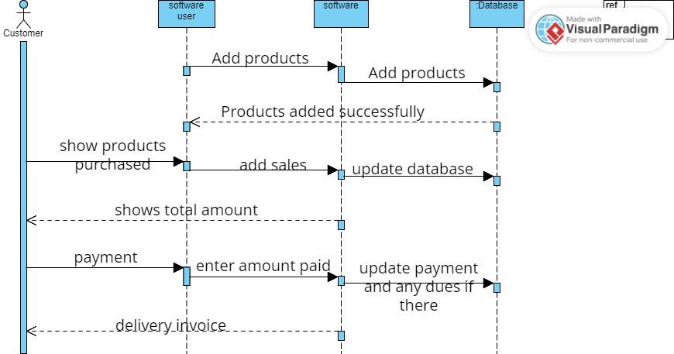
SEQUENCE DIAGRAM FOR ADDING AND SELLING PRODUCT

Slide 12
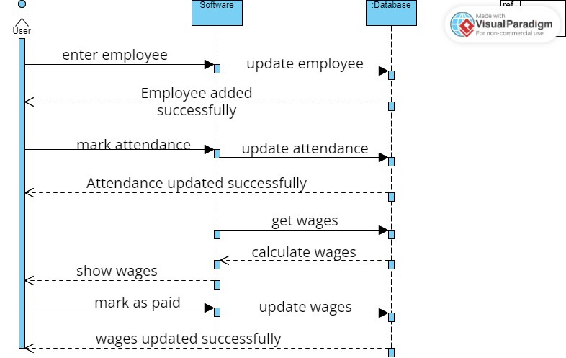
SEQUENCE DIAGRAM FOR ADDING EMPLOYEE, TAKING ATTENDANCE

Slide 13
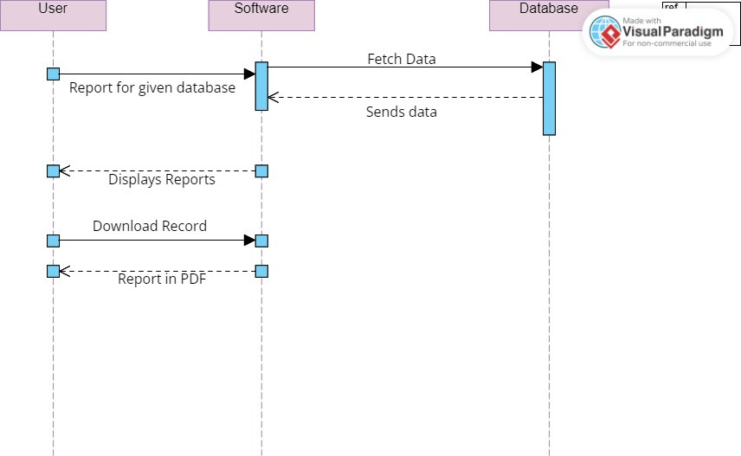
SEQUENCE DIAGRAM FOR GENRATEING REPORTS

Slide 14
ACTIVITY DIAGRAM
WE HAVE DIVIDED ACTIVITY DIAGRAMS INTO 3
1) Activity diagram for Product Sales
DESCRIBE HOW USERS CAN ENTER PURCHASE AND SALES PRODUCTS TO CUSTOMERS.
2) Activity diagram for Employee wages
DESCRIBES how to mark ATTENDANCE and wages
3)Activity diagram for downloading Reports
Desrbies how user can Genrate Reports Between any Two DAtes and download reports

Slide 15
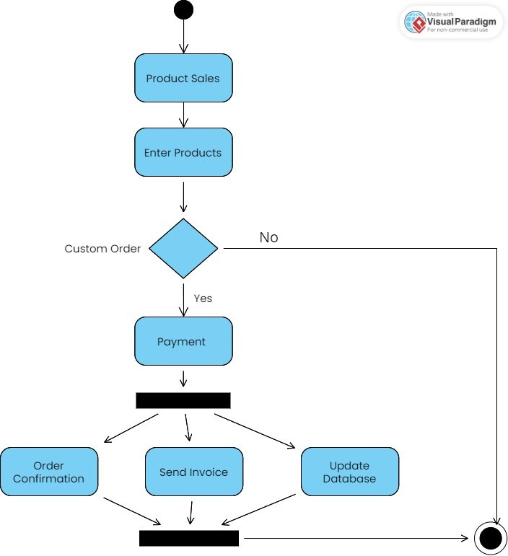
ACTIVITY DIAGRAM FOR PRODUCT SALES

Slide 16
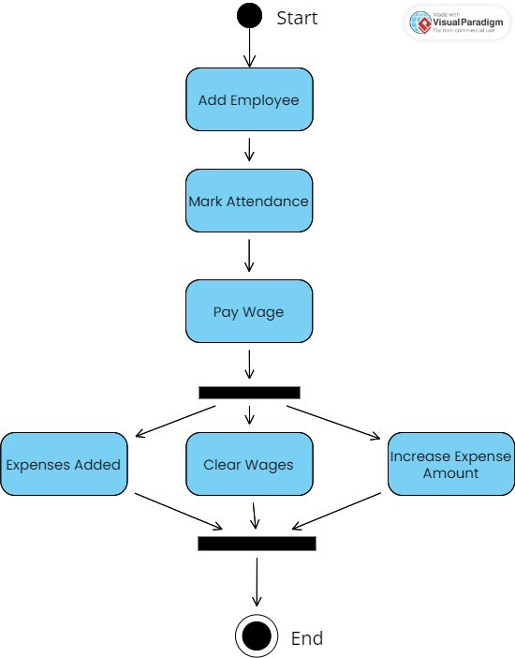
ACTIVITY DIAGRAM FOR EMPLOYEE WAGES

Slide 17
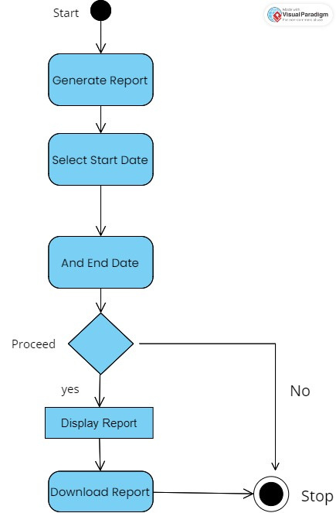
ACTIVITY DIAGRAM FOR DOWNLOADING REPORTS

Slide 18
CLASS DIAGRAM
CLASS DIAGRAM REPRESENTS ALL THE CLASSES, ATTRIBUTES AND FUNCTIONS IN THEM
CLASSES ARE DIVIDED INTO:
PRODUCT
CUSTOMER
VENDOR
CUSTOMER_DUE
VENDOR_DUE
PURCHASE
SALES
EXPENSES
EMPLOYEE
EMPLOYEE_ATTENDANCE
EMPLOYEE_WAGES

Slide 19
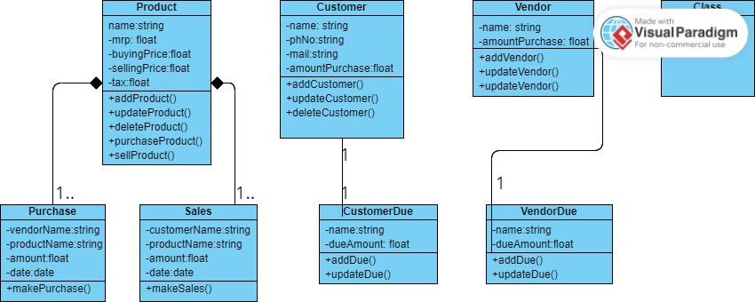
CLASS DIAGRAM

Slide 20
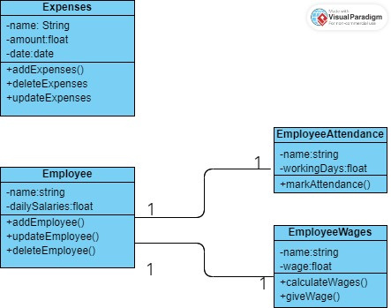
CLASS DIAGRAM

Slide 21
LINKS
Use case
HTTPS://ONLINE.VISUAL-PARADIGM.COM/COMMUNITY/SHARE/UNTITLED-1POKECRRSA
Sequence diagrams
https://online.visual-paradigm.com/community/share/sequence-diagram-1pok4gx4n1
https://online.visual-paradigm.com/community/share/sequence-diagram-1pokmybgcb
https://online.visual-paradigm.com/community/share/untitled-1opwa4zdrz

Slide 22
LINKS
ACTIVITY DIAGRAMS
HTTPS://ONLINE.VISUAL-PARADIGM.COM/COMMUNITY/SHARE/UML-ACTIVITY-DIAGRAM-1POORFRQQW
HTTPS://ONLINE.VISUAL-PARADIGM.COM/COMMUNITY/SHARE/UML-ACTIVITY-DIAGRAM-1POPEQY3XA
HTTPS://ONLINE.VISUAL-PARADIGM.COM/COMMUNITY/SHARE/UML-ACTIVITY-DIAGRAM-1POPSL7ESK
CLASS DIAGRAMS
HTTPS://ONLINE.VISUAL-PARADIGM.COM/COMMUNITY/SHARE/LAB-10-SOFTWARE-1PPMI81IXA
HTTPS://ONLINE.VISUAL-PARADIGM.COM/COMMUNITY/SHARE/LAB-10-SOFTWARE-1PPOMVBO3V

